Slide 1
Language Modeling
Week 3
Edward Ombui, PhD

Slide 2
Overview
This week, we will focus on language modeling, including building and evaluating n-gram models, which are crucial for tasks like text generation and machine translation.

Slide 3
Learning Outcomes
Explain the concept and purpose of language models in NLP.
Construct and evaluate n-gram models using a text corpus.
Understand the role of smoothing techniques in language modeling.

Slide 4
Language models in NLP
Language modeling involves the prediction of the next word or token in a sequence of words.
Language models: central in many NLP applications e.g. text generation, machine translation, sentiment analysis, and speech recognition.
Language models help computers understand the structure and flow of natural language, enabling them to process and generate text in a meaningful way.

Slide 5
Methods of Language Modelling
Statistical Language Modelling: is the development of probabilistic models that can predict the next word in the sequence given the words that precede. Examples such as N-gram language modeling.
Neural Language Modeling: are achieving better results than classical methods both on standalone language models and when models are incorporated into larger models on challenging tasks like speech recognition and machine translation. A way of performing a neural language model is through word embeddings.

Slide 6
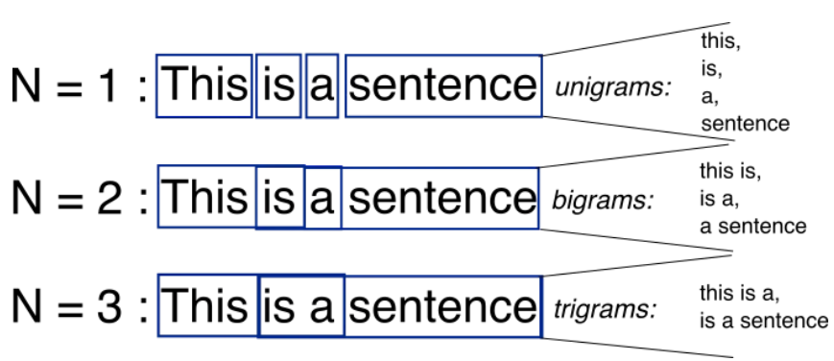
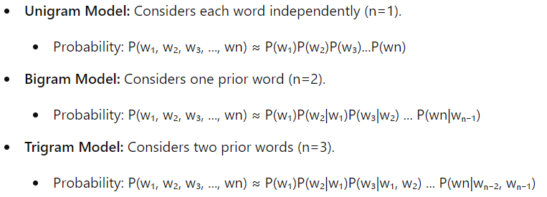
N-grams
Definition: An N-gram is a contiguous sequence of N items (words, characters, or other tokens) from a given sample of text or speech.
N-gram models are one of the simplest and most common types of language models.
They predict the probability of a word based on the previous n-1 words.

Slide 7
N-grams
Advantages
Limitations
Simplicity: N-grams are intuitive and relatively simple to understand and implement.
Low Memory Usage: They require minimal memory for storage compared to more complex models.
Limited Context: N-grams have a finite context window, which means they cannot capture long-range dependencies or context beyond the previous N-1 words.
Sparsity: As N increases, the number of possible N-grams grows exponentially, leading to sparse data and increased computational demands

Slide 8
Smoothing
One issue with N-gram models is the zero-probability problem, where an unseen word sequence results in a zero probability, which can make the model unreliable.
Smoothing techniques (like Laplace Smoothing, Good-Turing Discounting) are used to adjust probabilities for unseen sequences by distributing some probability mass to them.
Example: Given a bigram model and the sentence “I love NLP”:
P(“I love NLP”) ≈ P(“I”) * P(“love” | “I”) * P(“NLP” | “love”)

Slide 9
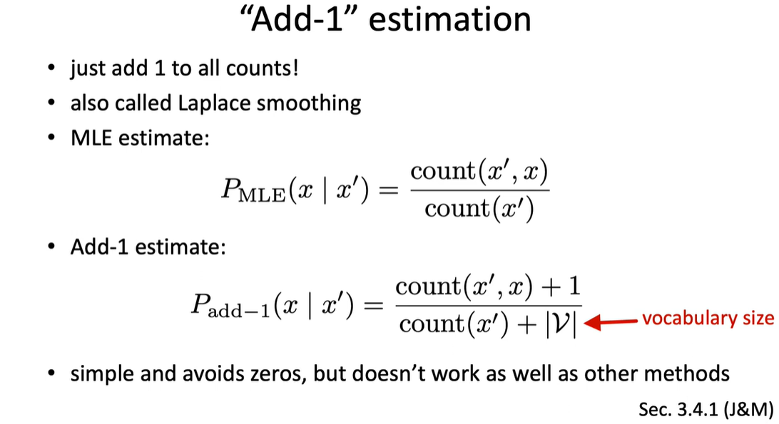

Slide 10
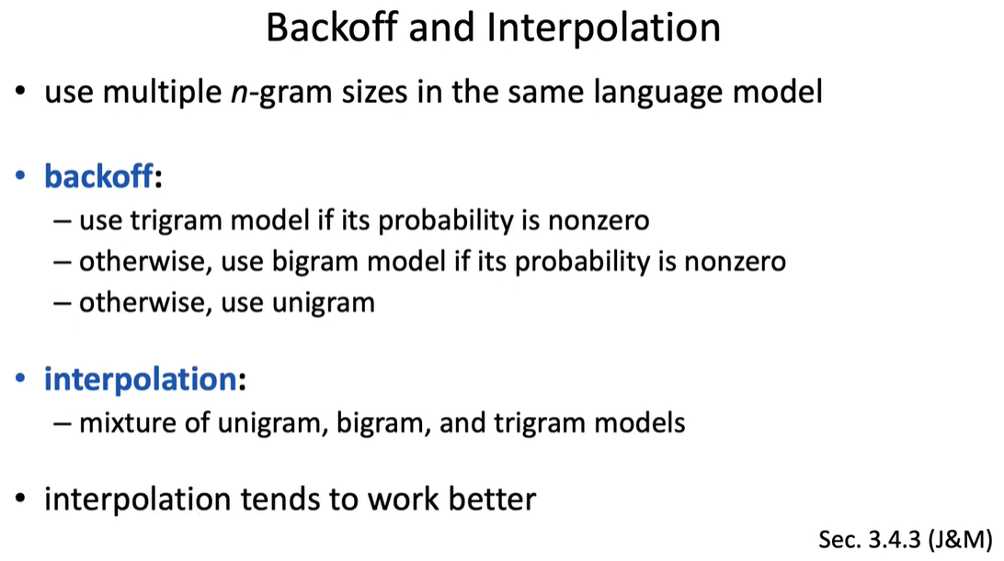

Slide 11
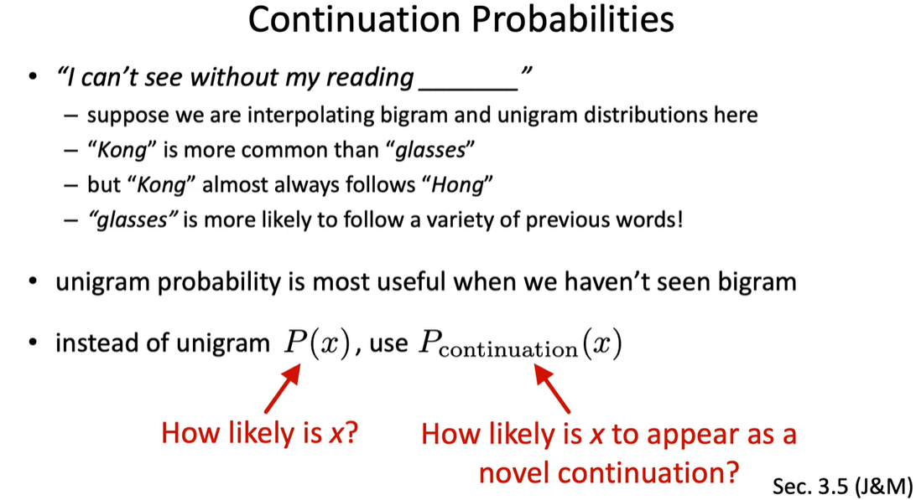

Slide 12
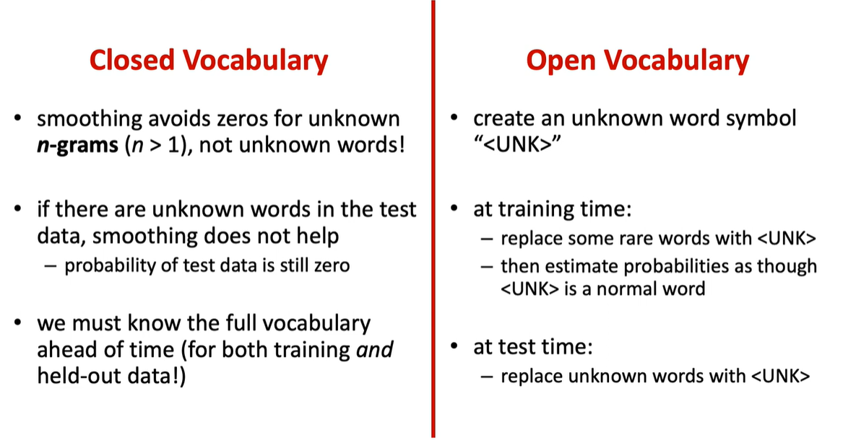

Slide 13
Model Evaluation
Perplexity: a measure of how good a probability distribution predicts a sample
Entropy: a measure of the amount of information conveyed
Cross Entropy: measures the ability of the trained model to represent test data

Slide 14
Perplexity
Perplexity measures how well a model predicts a test set and is defined as the inverse probability of the test set normalized by the number of words.
Formula: Perplexity(P)=P(w1,w2,...,wn)−1/n​
A lower perplexity value indicates a better language model, as it suggests the model is better at predicting the word sequence.
Example:
If a trigram model has a perplexity of 20, this means that, on average, the model considers 20 different words to be equally likely at each step of word prediction.

Slide 15
Lab: Implement a Bigram Language Model
Implementation of a bigram language model using Python and the Natural Language Toolkit (NLTK)
Train it on a text corpus and use it to generate new sentences.
Calculate perplexity for the trained bigram model on a test dataset.
Compare the perplexity with a trigram model.

Slide 16
Markov Models: Contextual Predictions

